Slide 1

Living Our three vows of poverty, chastity and obedience in an environmentally threatened world
Is the way we live today in our province good or bad for Planet Earth?

Slide 2
Getting to know a little about What is the history of our vows
What about our vow of poverty?
Let’s see what insights we can learn from the New Testament about our vow of poverty? But first what do our Constitutions say to us?
21. We commit ourselves to live simply and frugally, sharing our material, spiritual and intellectual gifts. We take reasonable care of our physical, mental and spiritual well-being. In the spirit of gospel simplicity and reverence, we joyfully forgo even necessities if the occasion arises, keeping in mind the words of Euphrasie Barbier that “we seek not a comfortable poverty which wants for nothing, but the real poverty of the cross” (Euphrasie Barbier, Letter to Mother Mary St Jude, Lyon, 10 October, 1885). What might the words of Euphrasie be saying to us today about living our vow of poverty in an environmentally threatened world? Do we have a comfortable poverty, or a real poverty of the cross?
22. By our vow of poverty we renounce the use and disposal of material goods. Personal gifts, salaries, pensions, insurance and income we receive, whose title was acquired after first profession, belong to the congregation. We live interdependently, sharing a common purse. We receive from the congregation according to our individual and communal needs.

Slide 3
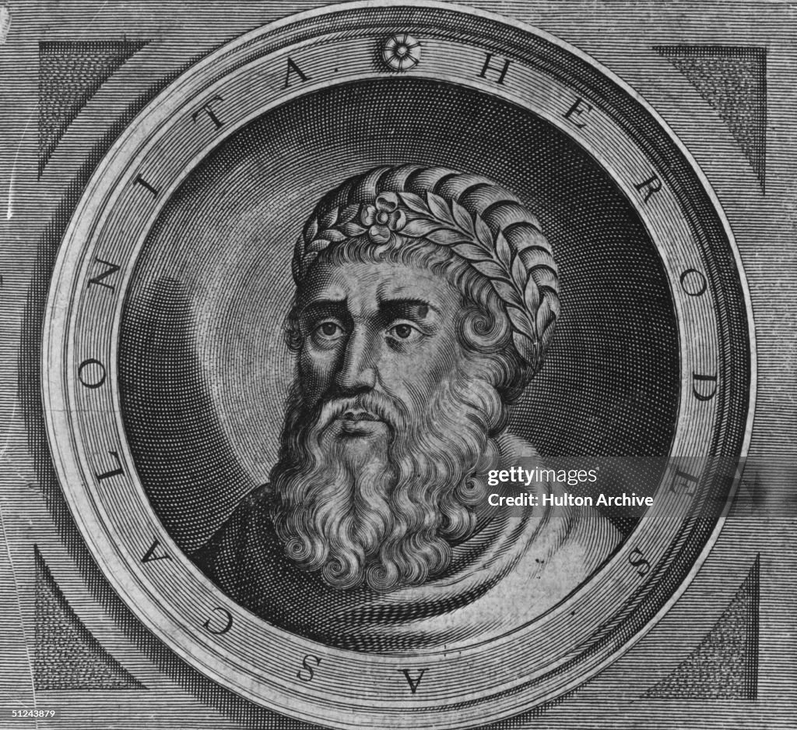
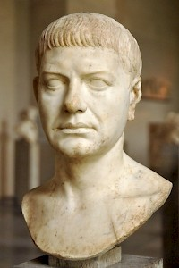
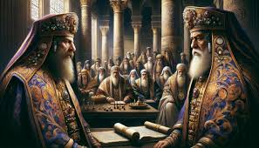
What about poverty in the gospels?
Let’s think back to our study of the gospels and recall the different people whom we met. Here are the “baddies” – Herod whom we read about in Matt 2 when baby boys are killed, Pilate who sentences Jesus to death, and the high priests who plotted his death
King Herod the Great, 30 BC-4 AD
Pontius Pilate, 10 BC-36 AD
Caiaphas, high priest, 14 BC-46 AD with Annas

Slide 4
Who’s who in Palestine at the time of Jesus? Check out these texts from the gospels
Zealots, Luke 6:15
Pharisees and Scribes, Mark 2:16; 7:1
Sadducees/Sanhedrin/Council, Mark 12:18; 15:1, 43
Peasants & village dwellers, Jesus, his disciples, Mark 1:16-20, Mark 6:30-44
Publicans/tax collectors, Mark 2:15-16
Sinners & outcasts, Mark 2:15-16
Roman Governor, Pontius Pilate, Mark 15:1-2
Herodians, friends of King Herod, Mk 3:6; 12:13
Priests at the temple, Mark 2:26,15:31
Read these verses from the gospels of Mark and Luke and then see where these different groups are placed on our social pyramid
The word “Zealot” might be new for you. It refers to those Jewish people who thought they should try and fight against the Romans. Remember Palestine was a Roman colony.

Slide 5
Palestine at the time of Jesus
Roman authorities
Priestly class
Sadducees
Managers and bailiffs of above
Scribes and Pharisees
Small landowners
Village artisans and Peasants
Landless labourers
Sinners and outcasts
Remember Jesus was a village artisan. Jesus had compassion on those below him on the social pyramid. Jesus was often in conflict with those above him on the social pyramid. He is killed by them at the end of his life
Conflict
Where would you put Jesus??
Compassion

Slide 6
Make a social pyramid of the country where you are currently living and working. Where are you going to place RNDMS?

Slide 7
Something to remember about Jesus:
The gospels of Luke (4:16) and John (8:8) suggest that Jesus could read and write
Luke’s gospel tells us that Jesus was born in a stable but Matthew’s gospel does not include this detail about the birth of Jesus
Joseph was a carpenter, a tradesman. Joseph, Mary, and Jesus seem to have had their own home at Nazareth (see Luke 2:43 which describes the family “returning home” to Nazareth)
Biblical scholars suggest that Joseph and Jesus might have worked as carpenters at Sepphoris, an imperial city that the Roman rulers were building. Sepphoris is 6 kms distant from Nazareth

Slide 8
Notice how the gospels show us that Jesus makes choices about his life.
Jesus chooses to be a wandering preacher, committed to proclaiming that the Reign of God is coming
Jesus invites his first four disciples – Peter and Andrew, James and John - to leave their fishing boats and their fathers and to come and follow him
Jesus tells his followers that the Son of Man has nowhere to lay his head
Jesus dies on the cross stripped of everything
Joseph of Arimathea provides a burial place for Jesus. His own biological and faith community could not have provided for a good tomb in a garden
What choices does a vow of poverty mean that you have to make about your life?

Slide 9
What can we learn about our vow of poverty from these gospel texts

Slide 10
What about our vow of chastity?
Virginity was esteemed in the Jewish religion, but virginity was not seen as a life-long commitment for Jewish women
Jewish people believed in the importance of marriage, and wanted plenty of children (see Psalm 123:8, “your children like olive plants around your table”)
Jewish religious practice insisted that women be virgins until they married
The idea of perpetual virginity comes from early Christianity, and is associated with the belief that Mary, the mother of Jesus, was a virgin before and after the birth of Jesus

Slide 11
Constitutions
14. Through the vow of chastity we freely respond to the mystery of God’s unconditional love in deep faith, inner freedom and radical availability for the reign of God. Captivated by the love of Jesus and led by the Spirit, we joyfully offer our lives and our creative energy to be in communion with God, with one another and with the whole of creation.
15. By our vow of chastity we commit ourselves to celibacy and to a life of chastity without compromise. By this obligation we freely commit ourselves to a chaste love, which is both profoundly human and deeply spiritual.

Slide 12
Something else to keep in mind
Something else to keep in mind. Do these three words have the same meaning – virginity, chastity, celibacy?
Virginity refers to a woman or man who has never had full sexual relations with another
Chastity means abstaining from sexual relations outside of marriage. Married couples are also required to be chaste, that is, refraining from sexual relations outside of their marriage
Celibacy means abstaining from any sexual activity

Slide 13
Traditionally, Christian teachings, Catholic and Protestant, around sexuality, have been INISISTENT THAT SEXUAL LOVE BELONGS TO MARRIED COUPLES. This has changed much in the Western world since women began using the pill. What about where you live?
Sexual activity was seen as something that belonged to married couples only. Married love was about having children only, not about enjoying sexual love with one’s husband or wife. Vatican II’s Gaudium et Spes, taught that marriage had two ends – procreative: conceiving a child, and unitive: uniting a husband and wife in love. This was a big change.
Pre-Vatican II teaching on the vow of chastity often warned of the dangers facing religious
As a novice, I learnt from the Catechism of the Vows “holding hands and other signs of sensual affection” were always seriously sinful.
In our NZ culture women did not tend to hold hands with one another so I was safe from that. I went to Papua New Guinea, and when we walked down to Sunday Mass, the local Sisters always held hands, and held my hand too. No serious sin involved in any of this. It was part of their culture

Slide 14
There are not so many texts that help us in our understandings around our vow of chastity in the NT. Matthew 19:12 refers to eunuchs. (Eunuchs were men who were incapable of having children and who often served in some royal courts)
Jesus says: ”For there are eunuchs who have been so from birth, and there are eunuchs who have been made eunuchs by others, and there are eunuchs who have made themselves eunuchs for the sake of the kingdom of heaven. Let anyone accept this who can” (Matt 19:12)
Jesus himself lived a celibate and chaste life. Peter was married as we read that Jesus heals Peter’s mother-in-law (see Mark 1:29-31)

Slide 15
Paul warns the communities to whom he writes about the danger of sexual immorality
See:
1 Corinthians 6:12-20 where Paul writes at length on sexual immorality, and concludes by teaching that our bodies are temples of the Holy Spirit
Paul 6:19-20 writes: ”Or do you not know that your body is a temple of the Holy Spirit within you, which you have from God, and that you are not your own? For you were bought with a price; therefore glorify God in your body” (1 Cor 6:19-20)
Today we live in a world where pornography and trafficking of people means that many do not respect others as “temples of the Holy Spirit within us”.
We have two RNDMs in New York whose ministry involves them with trafficked women. Are there RNDMs in your province involved with people who have been trafficked?

Slide 16
What can we learn about our vow of chastity from the New Testament

Slide 17
What about obedience in the NT?
What about obedience in our constitutions?
Our religious obedience commits us to listen attentively to God’s call as individuals and as members of the congregation. A particular understanding of obedience for us is our readiness to be sent. It challenges us to be open and responsive to the many ways God calls us throughout our lives. Euphrasie Barbier encourages us to be ever attentive to the “whisperings of grace” (Euphrasie Barbier, letter to Mother Mary St Teresa and the community, Deal, 15 February 1883).
Consecrated obedience is our free response to the infinite love of God. We publicly consecrate ourselves to follow Jesus, who in all circumstances of his life and mission, searched in faithful love to know and do what pleased the Father.
Our wholehearted response to the Divine Missions is possible only through the power of the Spirit.

Slide 18
Developments in the way we understand the presence of the holy Spirit
Before Vatican II (1962-1965), Catholics did not think too much about the Holy Spirit. Catholics tended to pray to God, Father and Son, and to Mary.
But our understanding about the presence of the Holy Spirit in our lives, in all creation, has meant big changes for us all since Vatican II
A new word for you perhaps, PNEUMATOLOGY, the theology of the Holy Spirit
Because we are temples of the Holy Spirit, because the Holy Spirit is present in all creation, in all cultures, our understandings around obedience, around care of creation, has evolved since Vatican II
Before Vatican II, we thought of and believed in the particularity of the Holy Spirit’s presence. The Holy Spirit was present above all in popes, bishops, priests and in our superiors. This was the presence that was all important
Now we believe in the universality of the Holy Spirit’s presence in all of us, in all creation and in all cultures. This is an important development, it is changing us in so many ways. Notice how Constitution 28 speaks about the power of the Holy Spirit

Slide 19
The vow of obedience – what we learn from the NT
Mark 3:31-35 Then Jesus’ mother and his brothers came, and standing outside they sent to him and called him. A crowd was sitting around him, and they said to him, “Your mother and your brothers are outside asking for you.” And Jesus replied, “Who are my mother and my brothers?” And looking at those who sat around him, he said, “Here are my mother and my brothers! Whoever does the will of God is my brother and sister and mother.”
Mark 14:36 Jesus prayed in the Garden of Olives “Abba, Father, for you all things are possible; remove this cup from me, yet not what I want but what you want.”
Luke 6:46 - “Why do you call me ‘Lord, Lord,’ and not do what I tell you?”
John 14:15 - “If you love me, you will keep my commandments.”
Acts 5:29 - But Peter and the apostles answered, “We must obey God rather than humankind.”
Luke 11:28 Jesus replied, “Blessed rather are those who hear the word of God and obey it.”

Slide 20
What about “The word of god?” and from where does it come to us?
I made my first profession in 1961, a year before Vatican II began, and it was very clear that the word of God came to us in the words of our superiors. I had never heard of the words “discernment” or “dialogue”. I recall getting a phone call from our provincial superior telling me I was to pack immediately and go to another convent and that I would be teaching in our college there. The sister whom I was meant to replace refused to move and so in the end I did not go. The other Sister later left the congregation!!!
Vatican II’s Gaudium et Spes, “The Church in the Modern World” no.4, reminds us to be aware of the “signs of the times,” that is know what is happening in our world and society as we are called to make decisions that hasten the Reign of God among us
In Laudato Si, Pope Francis speaks of the "cry of the earth" and the "cry of the poor.”
So today, we not only need to listen to the voice of our religious leaders but to other voices too – the society in which we live and work, the cry of the poor, and the cry of the Earth

Slide 21
Different voices so what are we to do?
We are all called to live in relationships of responsibility, trust and collaboration for the common good and availability for mission. We enter into dialogue and discernment with our leaders to enable us to share in the mission of the congregation to bring about the reign of God Constitution 26.
The congregation chapter is a collegial assembly representing the whole congregation. While in session it is the highest legislative authority in the congregation. As a moment of reflection and discernment it is an occasion for reviewing, in the light of the gospel, the life of the whole congregation and fidelity to our religious missionary identity. Attentive to the guidance of the Spirit, the chapter decides the directions necessary for renewal according to the needs of the world. (Can. 631, §1), Constitution 100

Slide 22
The word “discernment” as we understand it in our religious life comes to us from St Ignatius, founder of the Jesuits
Ignatian discernment, sometimes called “discernment of spirits,” is the spiritual practice of noticing the movements within our heart and soul — our desires, thoughts, emotions — and identifying where they are coming from and where they are leading us (Office of Ignatian Spirituality)
Discernment happens at the personal level as individuals recognize their need to make an important decision, e.g., discernment is important for novices and their formators as decisions are being made about going ahead with first profession
Discernment is also very important when RNDMs gather together for congregation chapters or province gatherings. Discernment is about listening to different voices through which the Holy Spirit, the Triune God, speak to us, those “whisperings of grace” that Euphrasie wrote about, see Constitution 26.
Discernment is about more than listening to your own voice. We have to listen to other voices, our leadership teams, our provinces/regions, our communities, the cry of the poor, the cry of the earth

Slide 23
Never forget about the Holy spirit who speaks to us through so many different voices
When decisions are made nowadays we need to be aware of the different ways through which the Spirit speaks to us.
This is why discernment is so necessary as that requires careful listening on all sides
This is why dialogue is so necessary as no one has all the insights needed when important personal, community, provincial and congregational decisions are being made

Slide 24
How did we get our three vows of poverty, chastity and obedience?
All religions have people, women and men, who demonstrate in a public way their commitment to a life that speaks to others about certain values that are important for all of us to live by
There are Buddhist nuns and monks
There are Sannyasi, and Sahu (holy men) in Hinduism, who often wear saffron coloured robes, the colour of the saris worn by many of our Indian and Bangladeshi sisters
There are imans, or prayer leaders in Islam
There are holy men and women in the many tribal religious communities among whom our sisters live and work

Slide 25
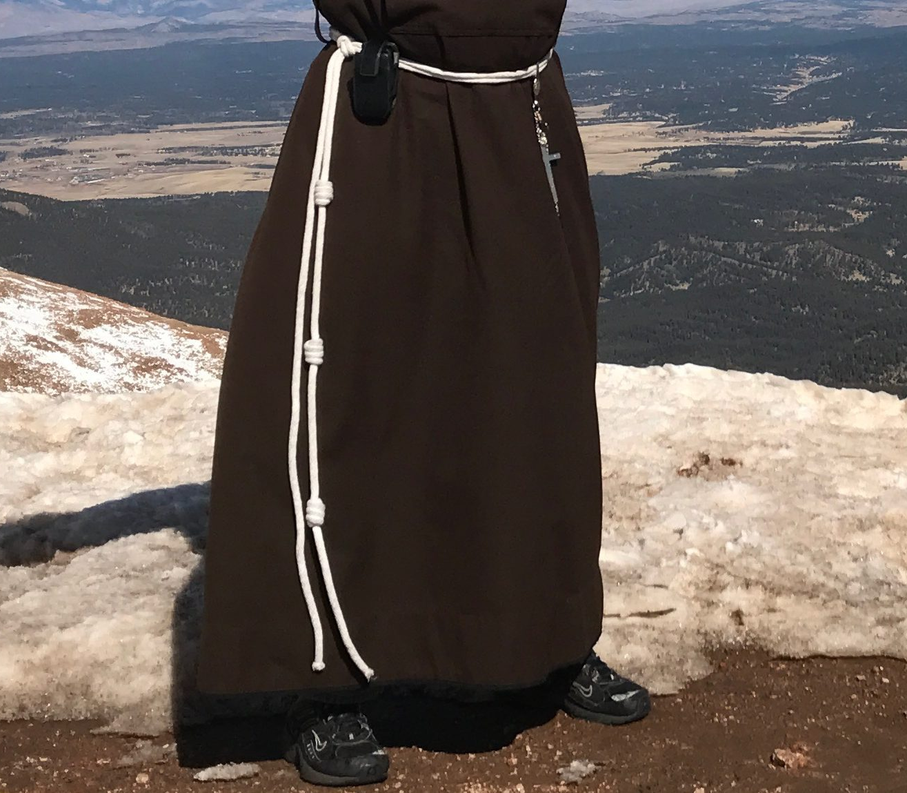
What about in our Catholic story?
St Benedict (480-547) is the father of Western monasticism, and when he began to gather men around him, they did not make vows of poverty, chastity and obedience. The Benedictine monks and Benedictine sisters make vows or promises of
stability, fidelity to the monastic way of life, and obedience
which included poverty and chastity.
St Francis of Assisi (1181-1226) wanted his followers to make
vows of poverty, chastity and obedience, in imitation of Jesus of Nazareth
Franciscan monks, nuns, and sisters today all have the three knots in the cord they wear to remind them of these three vows

Slide 26
In 1534, the Jesuits were founded by Ignatius of Loyola, and they made three vows – poverty, chastity and obedience, and a fourth vow of obedience to the pope
In 1633, the Daughters of Charity were founded in Paris by Vincent de Paul and Louise de Marillac to serve the poor. Church authorities thought Catholic women should be contemplative nuns, e.g., Carmelites, not apostolic sisters. Vincent a clever canon lawyer got around this. The Daughters of Charity do not make perpetual vows, they make annual vows and so cannot be regarded as proper nuns. Today there are 16,000 Daughters working in more than 90 countries
In 1861, when Euphrasie founds the Sisters of Our Lady of the Missions, the Sisters made three vows of poverty, chastity and obedience
So we can see, that thinking around the three vows is not uniform, and not the same for everybody

Slide 27
We have looked, very briefly, at our three vows in the Western Catholic story as that is the story that has influenced us as RNDMs
What are three things you have learnt that you never knew before?
How will these new insights help you understand what being an RNDM will require of you today and tomorrow?

